Slide 1
System structure of a database
4

Slide 2
Today’s Agenda
Disk Storage
Storage Manager
Query Processor
Users and Its interaction

Slide 3
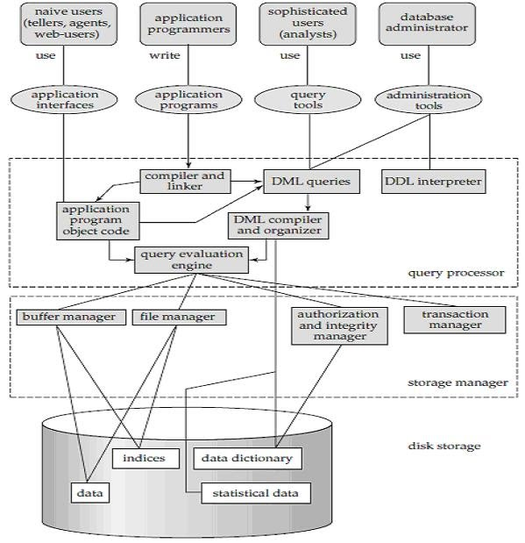
System structure of a database or Architecture of DBMS

Slide 4
Disk Storage
Starting from very beginning we know that the disk storage or the physical storage is use for storing the data. In many big enterprises, the database range in size from hundred of gigabytes to terabytes of data. The main memory is not so large that it holds that much information and data. So we need a larger disk storage for the database.
Components are as follows:
Data, Indices, Data Dictionary, Metadata, Statistical Data

Slide 5

Index
Indexing is used to optimize the performance of a database by minimizing the number of disk accesses required when a query is processed.
The index is a type of data structure. It is used to locate and access the data in a database table quickly.

Slide 6
Metadata
Metadata is simply data about data. It means it is a description and context of the data. It helps to organize, find and understand data. Here are a few real world examples of metadata:
Title and description,
Tags and categories,
Who created and when,
Who last modified and when,
Who can access or update.

Slide 7
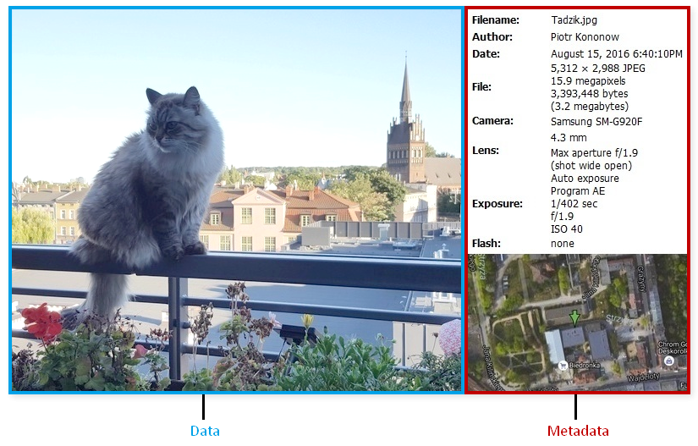
Metadata
Every time you take a photo with today's cameras a bunch of metadata is gathered and saved with it:
date and time,
filename,
camera settings,
geolocation.
Source: https://dataedo.com/kb/data-glossary/what-is-metadata

Slide 8
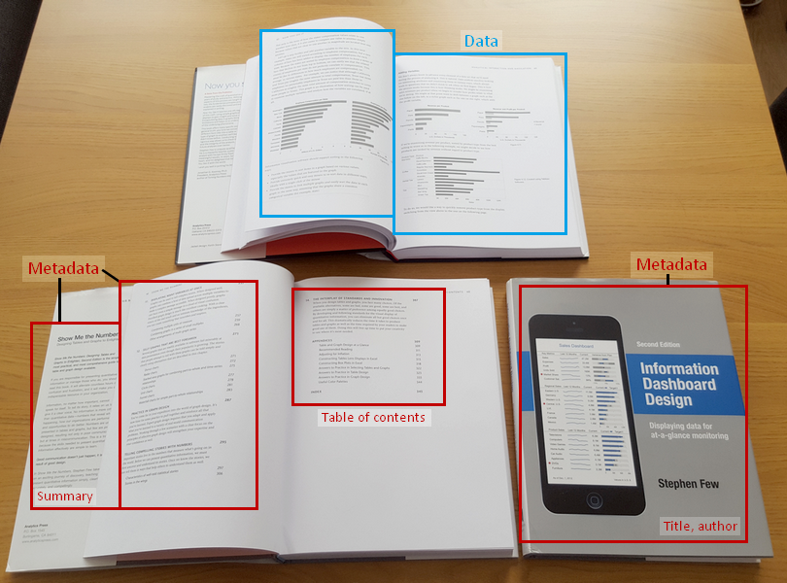
Metadata
Each book has a number of standard metadata on the covers and inside. This includes:
a title,
author name,
publisher and copyright details,
description on a back,
table of contents,
index,
page numbers.
Source: https://dataedo.com/kb/data-glossary/what-is-metadata

Slide 9
Data Dictionary
Attribute | Required | Format
SID | Yes | Text + Number
SNAME | Yes | Text
ADDRESS | No | Text
Mobile | Yes | Number
Email | No | Text + Number
Birth Date | Yes | Date
Age | Yes | Number
Constraints
Primary Key
NOT NULL
NOT NULL
NOT NULL
NOT NULL

Slide 10
Data Dictionary
A data dictionary is a file or a set of files that contains a database's metadata. The data dictionary contains records about other objects in the database, such as data ownership, data relationships to other objects, and other data. The data dictionary is a crucial component of any relational database. It provides additional information about relationships between different database tables, helps to organize data in a neat and easily searchable way, and prevents data redundancy issues. Ironically, because of its importance, it is invisible to most database users. Typically, only database administrators interact with the data dictionary.
In a relational database, the metadata in the data dictionary includes the following:
Names of all tables in the database and their owners.
Names of all indexes and the columns to which the tables in those indexes relate.
Constraints defined on tables, including primary keys, foreign-key relationships to other tables, and not-null constraints.
Additional physical information about the tables including their storage location, storage method, etc.

Slide 11
Query Processor
The query processor components include:
DDL interpreter, which interprets DDL statements and records the definitions in the data dictionary.
DML compiler, which translates DML statements in a query language into an evaluation plan consisting of low-level instructions that the query evaluation engine understands.
A query can usually be translated into any of a number of alternative evaluation plans that all give the same result. The DML compiler also performs query optimization, that is, it picks the lowest cost evaluation plan from among the alternatives.
Query evaluation engine, which executes low-level instructions generated by the DML compiler.

Slide 12
Storage Manager
A storage manager is a program module that provides the interface between the lowlevel data stored in the database and the application programs and queries submitted to the system. The storage manager is responsible for the interaction with the file manager. The raw data are stored on the disk using the file system, which is usually provided by a conventional operating system. The storage manager translates the various DML statements into low-level file-system commands. Thus, the storage manager is responsible for storing, retrieving, and updating data in the database.
The storage manager components include:
Authorization and integrity manager, which tests for the satisfaction of integrity constraints and checks the authority of users to access data.
Transaction manager, which ensures that the database remains in a consistent (correct) state despite system failures, and that concurrent transaction executions proceed without conflicting.
File manager, which manages the allocation of space on disk storage and the data structures used to represent information stored on disk.
Buffer manager, which is responsible for fetching data from disk storage into main memory, and deciding what data to cache in main memory. The buffer manager is a critical part of the database system, since it enables the database to handle data sizes that are much larger than the size of main memory.

Slide 13
Transaction Manager
A transaction is a collection of operations that performs a single logical function in a database application. Each transaction is a unit of both atomicity and consistency. Thus, we require that transactions do not violate any database-consistency constraints. That is, if the database was consistent when a transaction started, the database must be consistent when the transaction successfully terminates. Transaction - manager ensures that the database remains in a consistent (correct) state despite system failures (e.g., power failures and operating system crashes) and transaction failures.

Slide 14


